Slide 1
Brick Breaker
Code Ninjas Crestwood
Tristin schlauch

Slide 2
Hello, World!
Welcome everyone and thank you for joining! I hope you’re excited to develop games in Python! Over the next 3 weeks, we’ll learn about:
The basics of Pygame Zero
How to use variables for sprites and other global game attributes
Boolean logic, if statements, as well as and, or, and not
How to use for-loops to create an array of bricks for us to destroy
How to use lists so we can interact with multiple bricks and power-ups
How to randomly spawn different power-ups
How to use timed functions to create different power-up effects
How to use comments to organize our code

Slide 3
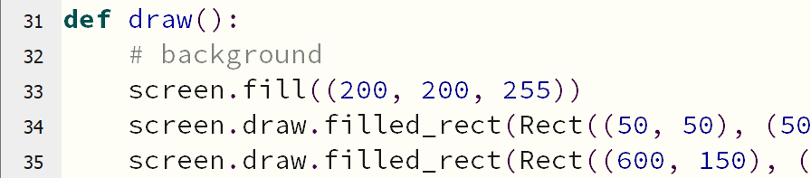
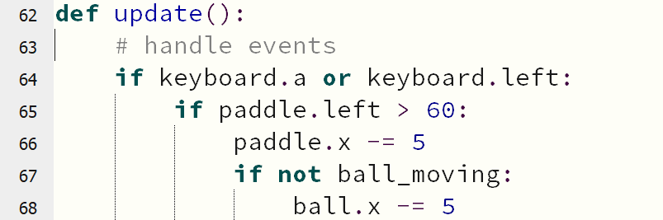
Pygame Basics
Pygame Zero runs a visual, graphical game one frame at a time
On each frame, the game will:
Handle all inputs (like keyboard and mouse buttons)
Draw our game
Update our game
This repeats until the game ends

Slide 4
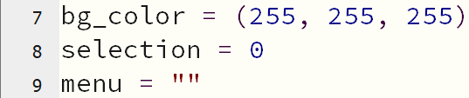

Creating the Window With Variables
Variables are used to store information so that we can use them later
Basically, a variable is a name that we give to a piece of information we want to remember
Let’s set our game window HEIGHT to 600 and WIDTH to 800!

Slide 5
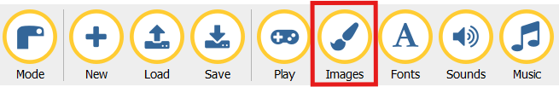
Creating the Paddle
Let’s make our paddle! Click on the Images button on your editor to see the images we’ll use.
To create our paddle, we need to make an Actor using the image name that we want to use and save it to a variable

Slide 6

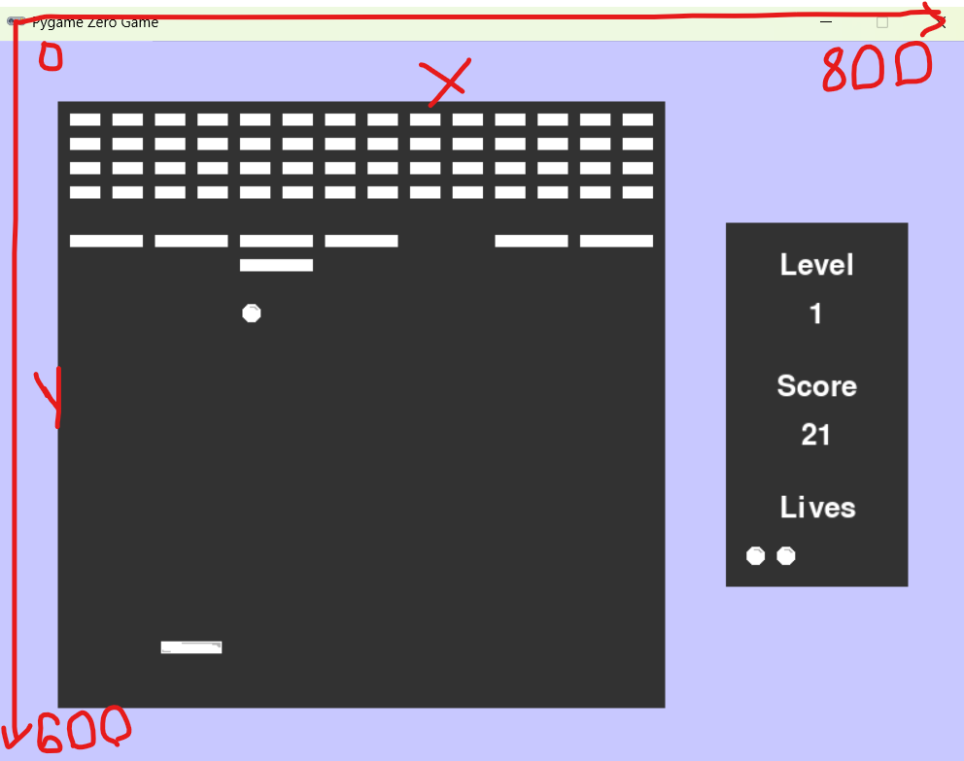
Repositioning the Paddle
Now that we’ve created the paddle, let’s reposition it!
To do this, we’ll set the paddle’s center attribute by using “paddle.center”
Then we’ll use brackets to set the paddle’s (x, y) positions
Press Play to test your project!

Slide 7

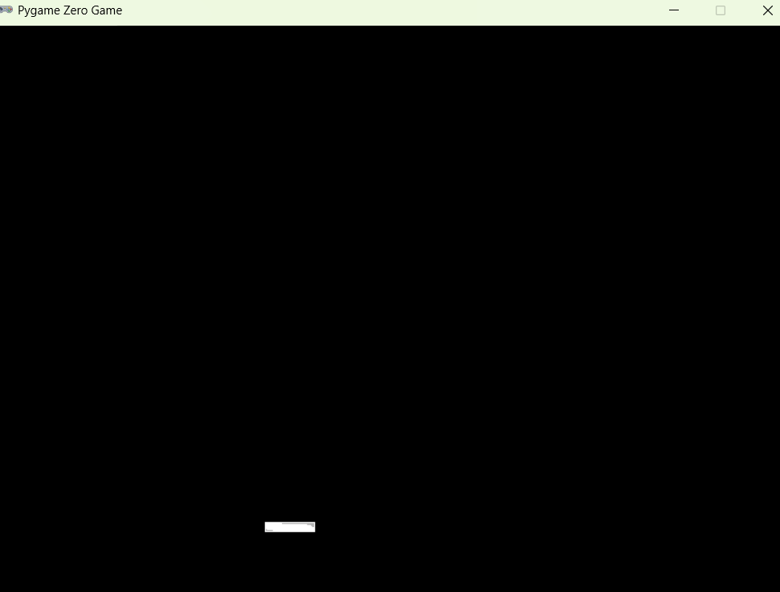
Drawing the Paddle
Oh no! There’s nothing on the screen! That’s because we never drew the paddle on the screen.
Go to the draw function on your editor, erase pass and type “paddle.draw()”
Now, press Play to see your paddle!

Slide 8
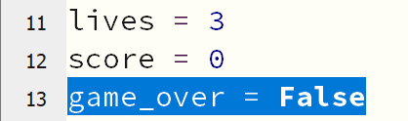
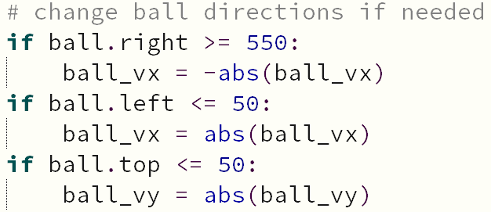
Booleans and If statements
Next, we’re going to learn how to move the paddle, but first we need to learn about Booleans!
Booleans are statements that are either True or False
Usually, you use them with an if-statement to do certain things if a condition is True!

Slide 9
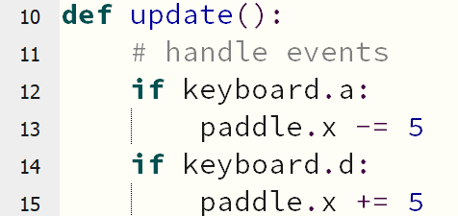
Moving the Paddle
Moving the paddle is a game update, so this code needs to go in the update function!
Code so that if our player presses the “a” button, the paddle moves left by updating the paddle’s x attribute
Also code so that if they press “d”, they move right

Slide 10
Woah! Our paddle is all over the screen! How can we fix that???

Slide 11
Drawing a Background
Remember that Pygame Zero is frame-by-frame. So, on EVERY SINGLE FRAME, we need to reset the screen
Make sure that we arrange the stuff in the draw function in the order that we want it drawn!
We can fill the screen by using screen.fill((red, blue, green))
red, blue, and green can be any number from 0-255
We can also make some other rectangles for our game’s boundaries

Slide 12
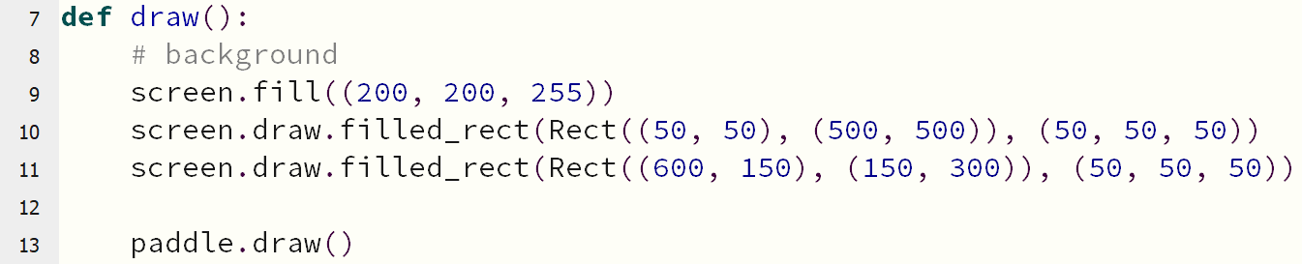
Drawing a Background

Slide 13
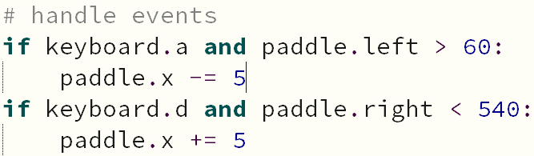
Moving the Paddle – Part 2
Our paddle can go wherever it wants to! We need to stop that by updating the if-conditions.
To add another condition to the if-statement, we join them by using the word “and”
Combine the button statements with conditions that check the position of our paddle to ensure it doesn’t move too far!

Slide 14



Drawing the Ball
Next, make the ball by creating another Actor
Set its position using ball.center
Remember to draw the ball in the draw method!
Test your game when you finish!

Slide 15
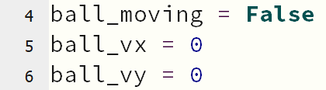
Moving the Ball – Part 1
To start, let’s define three new variables above your paddle and ball Actors:
Set a ball_moving variable to False
Set a ball_vx variable to 0
Set a ball_vy variable to 0

Slide 16
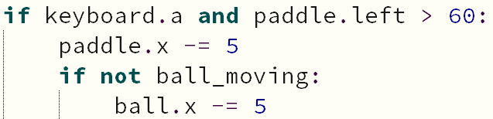
Moving the Ball – Part 2
Next, in the update method, move the ball with the paddle if the ball isn’t moving
Use an if-statement to check if the ball is not moving
If not, move the ball at the same speed as the paddles
Do this for both directions
Test the game!

Slide 17
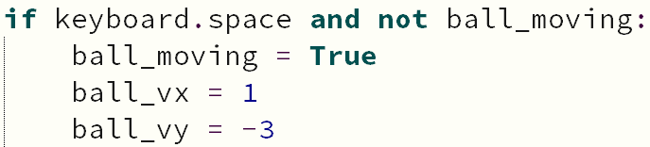
LAUNCHING the Ball – Part 1
Code the SPACE BAR to launch the ball!
Create a new if-statement in the update method to check if the space bar is pressed AND the ball is not moving
Then:
Set ball_moving to True
Set ball_vx to 1
Set ball_vy to -3

Slide 18
Oh no! Our code doesn’t work!

Slide 19
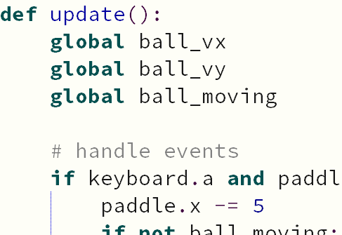
LAUNCHING the Ball – Part 2
We need to make our variables global so that the update method knows which ones we’re talking about
At the very top of our update method, make ball_vx, ball_vy, and ball_moving global variables by typing each of their names with the word “global” before it

Slide 20
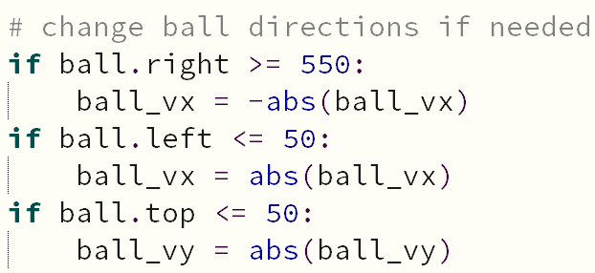
Bouncing the Ball
Now our ball flies off the screen! It should bounce on the walls!
We need to add another section to our update method that checks the position of the ball and changes its velocity if needed
abs() stands for “absolute value”, which makes the value inside the brackets positive

Slide 21

Hitting the Ball
Next, we need to have our ball bounce off the paddle.
For this, we need to use the colliderect() method
This method checks if two sprites have collided with each other. It returns True if they have and False if they haven’t
This method can be used with an if-statement to run some code when two sprites overlap

Slide 22
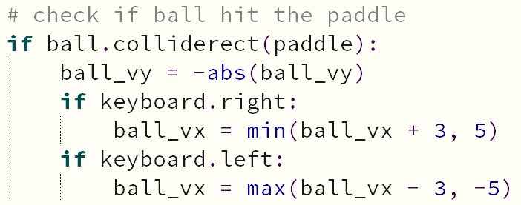
Hitting the Ball
Put this section of code in your update function
We change the ball’s direction with the first line of code
Then, we let the player “push” the ball in one direction with the other lines of code

Slide 23
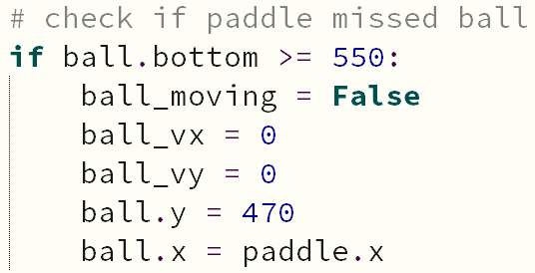
Resetting the Ball
What happens if we miss the ball? How can we tell in the game if we missed the ball?
This section of code goes in the update function
If the ball reaches a certain y value, we should:
stop moving the ball,
set its speed to 0,
and reset its position

Slide 24
Creating the Bricks – For Loops
We can easily create one brick for our project, but how can we make a whole bunch of bricks easily?
To do this, we’ll use something called a for loop
A for loop is something that we can use to repeat the same code so the same thing multiple times. For this project, we’ll use it to create an array of bricks.

Slide 25
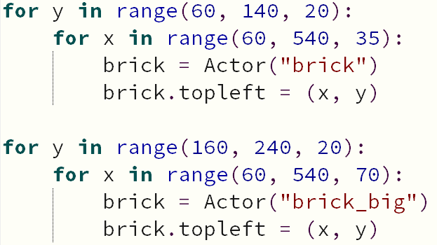
Variable
Start
Stop
Step

Slide 26
Drawing the Bricks – Lists and For Loops
Now we have created our bricks, but how do we draw them?
We can’t draw them the same way that we draw the paddle and ball because the bricks don’t have a unique name!
For this, we’ll store all of the bricks in a list and use a for element loop to draw all of the bricks in the list
In Python, a list is indicated by two square brackets: []

Slide 27
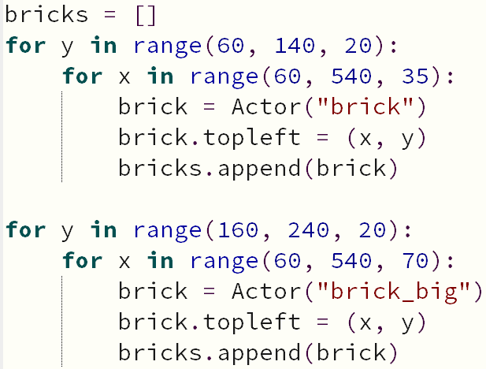
Drawing the Bricks – Part 1
To create a new list, assign a new variable to an empty list: []
To add stuff to the list, uses the list’s name, .append(), and put the stuff that you want to add to the list inside the brackets

Slide 28

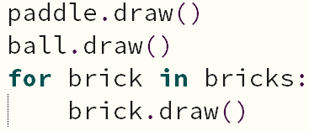
Drawing the Bricks – Part 2
Now, we’ll use a for element loop in the bottom of the draw function to draw the bricks
You should draw every brick in the bricks list

Slide 29
Hitting the Bricks – CollideList
Now, we need the ball to hit our bricks
Just like we can’t draw the bricks the same way as we drew the paddle and ball, we can’t check for collisions the same way either
Now, we’ll check if the ball collided with any brick in the bricks list by using ball.collidelist(bricks)
If the ball didn’t collide with any brick, this value will be -1. If it did collide, it will return a number bigger than or equal to 0 that represents which brick the ball hit
How can you use this with an if-statement to run some code when the ball hits a brick?

Slide 30
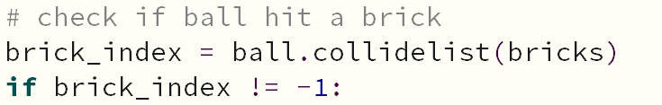
Hitting the Bricks – PaRt 1
This section of code will go in the bottom of your update function
First, find out the value of ball.collidelist(bricks), then see if it is not equal to -1
If it isn’t -1, we must’ve hit a brick!

Slide 31
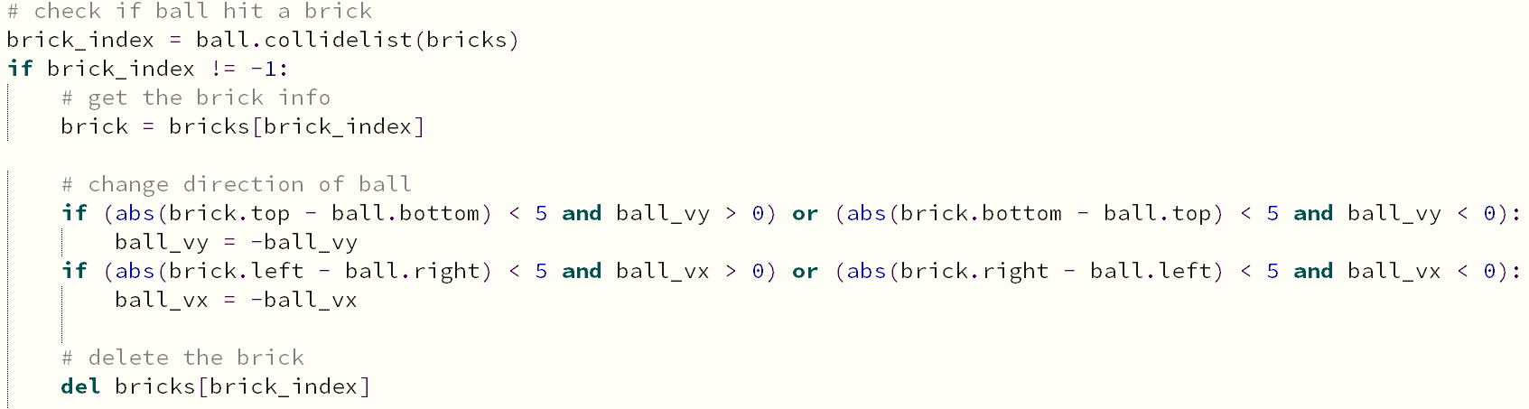
Hitting the Bricks – PaRt 2
When we hit the bricks, three things should happen:
The ball should change direction
The brick should be destroyed
The score should increase

Slide 32
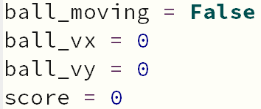
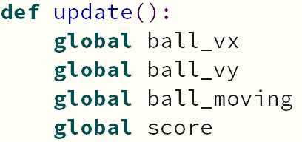
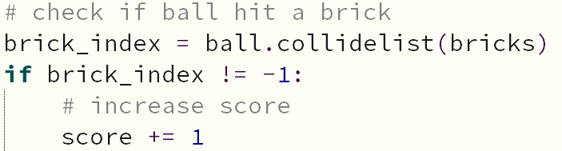
Increasing the Score
Before we can increase the score, we need to create the score!
At the top of our game, set a new score variable to 0.
At the top of the update function, use the global score
In the ball-brick collision if-statement, increase the score by 1

Slide 33
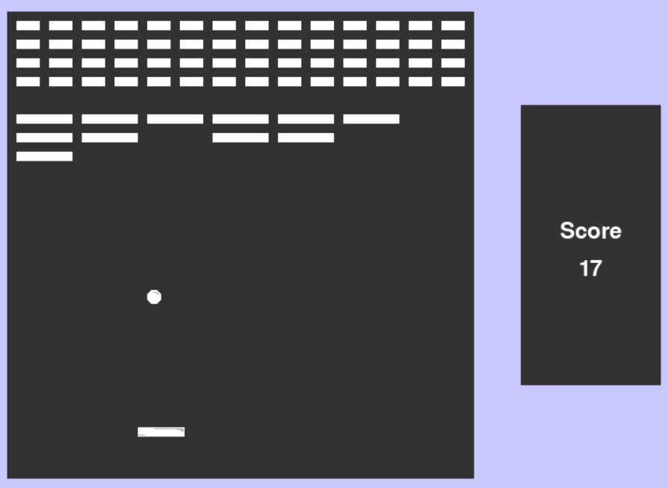
Drawing the Score
Our game increases the score, but how can we tell? We need to draw our score to the screen!
Put this code under the background in the draw function

Slide 34
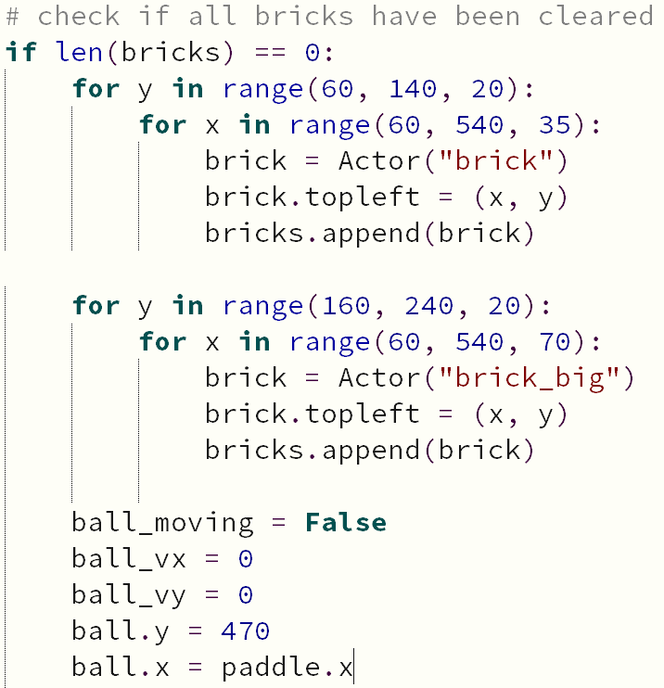
RESETTING the Bricks
When we clear all of the bricks, we want to reset them so the player can keep playing!
We can check if the player has cleared all the bricks by checking if the list of bricks is empty!
In Python terms, this means that the length of the bricks list is 0

Slide 35
Hmmmm… doesn’t this code look familiar?

Slide 36
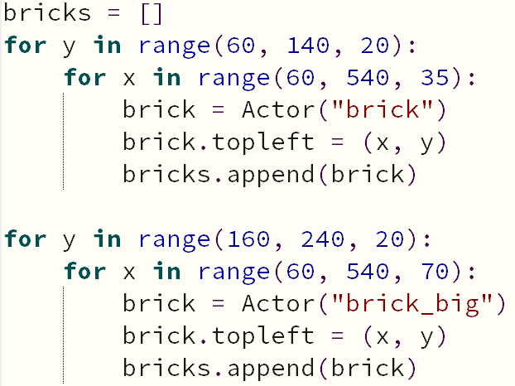
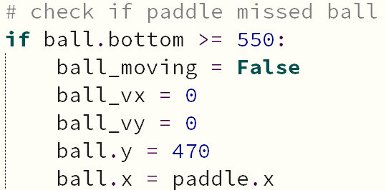
Repeated Code – Functions – Part 1
We’ve used this exact code before!
To remove this repeated code, we can use something called a function
A function is a special section of code that we give a name to so that we can easily use that code anywhere else in our game

Slide 37
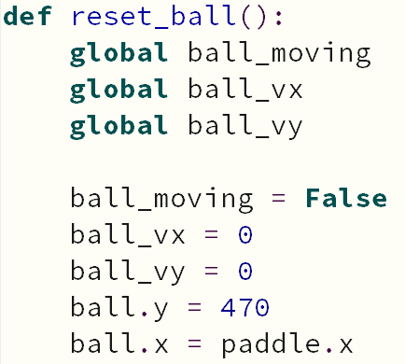
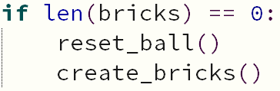

Repeated Code – Functions – Part 2
To define a function, type def, give the function a name, then add your code
REMEMBER! If you use any variables that you defined at the start of the game, you need to make them global!
To use this code, you need to call the function in the place you want to use it by typing the function’s name

Slide 38
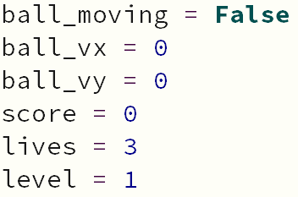
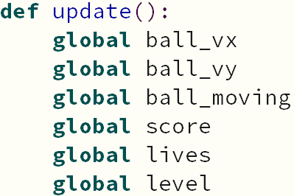
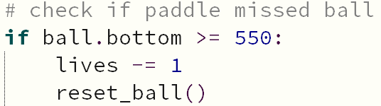
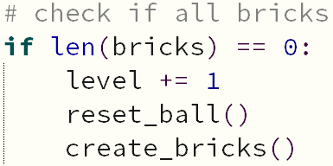
Tracking the Level and Lives
We can also add in variable that track the level we’re on and how many lives we have left
Add new variables at the top of your code and make them global in the update function
Lose a life when you miss the ball and increase your level when you clear all the bricks

Slide 39
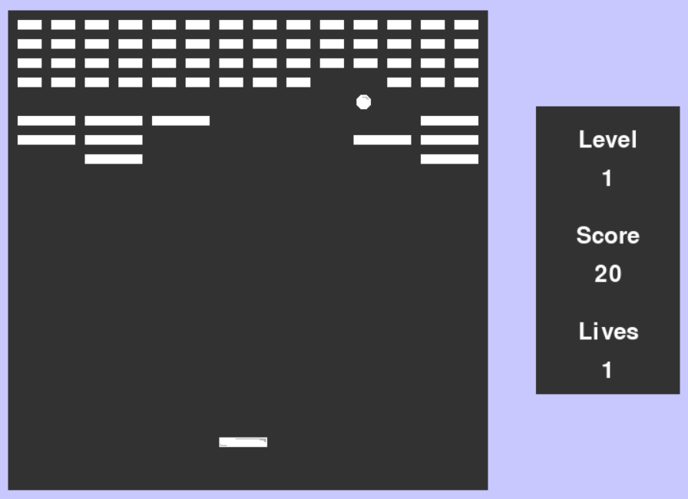
Drawing the Level and Lives
Don’t forget to draw them in the draw function!
Put this in the same section where you draw the score to the screen

Slide 40
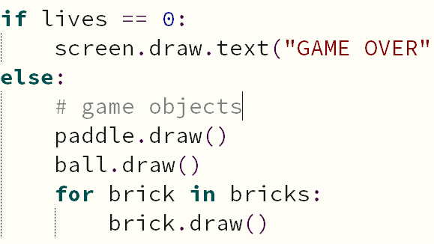
Running Out of Lives
When we have no more lives, the game should end!
In the bottom of your draw function, create a new if-statement that checks if we have 0 lives
If we are out of lives, draw “GAME OVER” text on the screen
Under this, put an else statement and move the paddle, ball, and brick drawing code into it

Slide 41
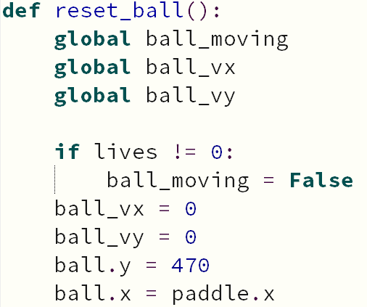
Ending the Game
We also need to prevent the player from continuing to play
In the reset_ball function, change the code so that you set ball_moving to False only if you do not have 0 lives
Test out your game!

Slide 42
Power-ups
Check out your Images folder for the power-ups we’ll use!
You should notice 3 power-ups:
extra_life
size_up
widen
You should also notice:
ball_big
paddle_big

Slide 43

The Random Module
With every brick you break, you will have a chance to spawn a power-up
The power-up spawned will be randomly selected
Both of these things can be done with the random module
Before we can use the random module, we must import it

Slide 44
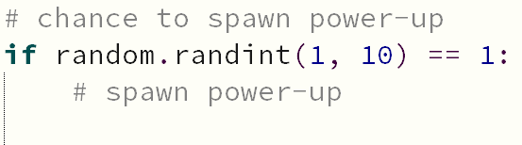
Creating The Power-ups – Part 1
With every brick we break, we have a chance of spawning a power up
To do this, we’ll generate a random number using random.randint(a, b) to simulate a “% chance”
If the “% chance” is a success, we’ll spawn a power-up!
This code will go in the ball-brick collision if-statement

Slide 45
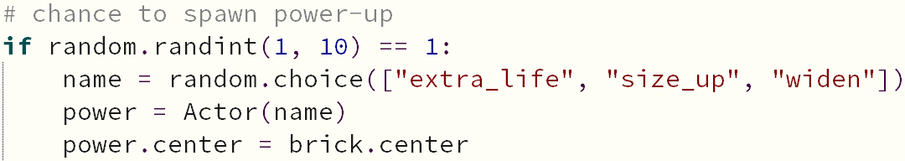
Creating The Power-ups – Part 2
The power-up that we spawn should be randomly chosen
To do this, we’ll randomly select one of the power-up names from a list using random.choice() to choose which power-up to spawn
Remember to create an Actor for the power-up and set its position

Slide 46

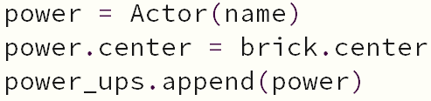
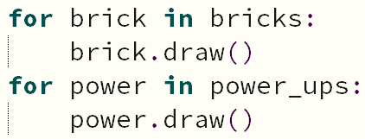
Drawing The Power-ups
To draw the power-ups, we’ll do the same thing that we did for the bricks
Add all the power-ups to a new list when we create them
Use a for-loop to draw all the power-ups in the draw function

Slide 47
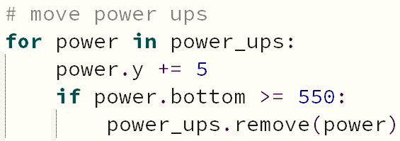
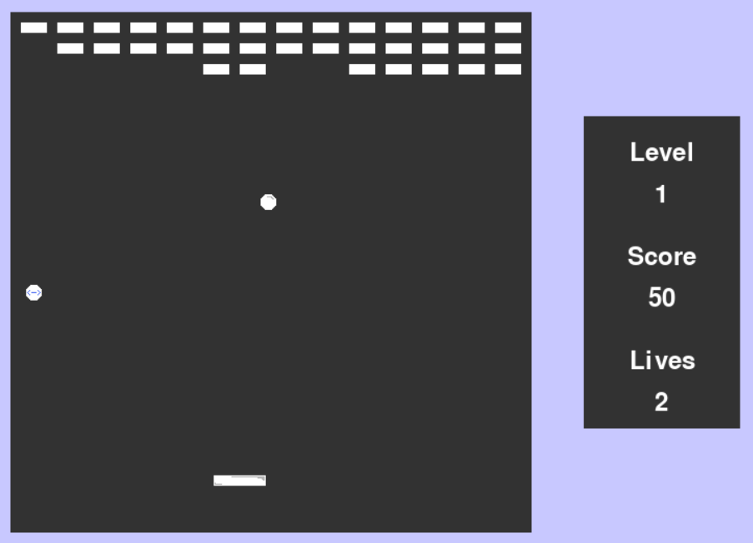
Moving The Power-ups
Just like we need to use a for-loop to draw all the power-ups, we need to use a for-loop to move all the power-ups
In the update function, use a for-loop to move every power in the power-ups list
Also, add code to delete the power-up if it reaches the bottom of the screen

Slide 48
Collecting The Power-ups
We’ll use paddle.collidelist(power_ups) to check if the paddle has overlapped with any power-ups the same way we checked if the ball overlapped any bricks
If the paddle did overlap a power-up, we need to check what image it is and give the player the appropriate power
If the power’s image is extra_life, increase the player’s lives by 1
If the power’s image is size_up, change the ball’s image to ball_big
If the power’s image is widen, change the paddle’s image to paddle_big
After using the power-up, delete it from the power_ups list

Slide 49
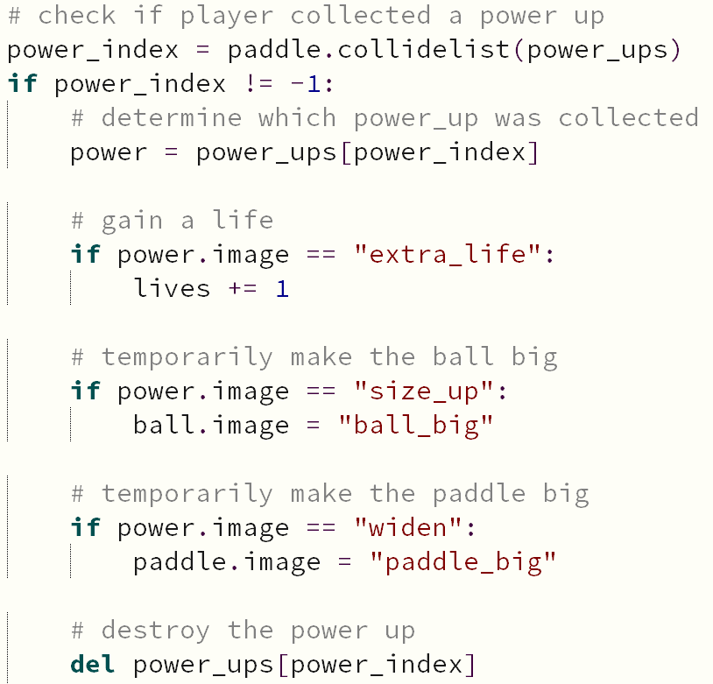

Slide 50


Ending The Power-ups – Part 1
Right now, once we collect the power-ups that boost the size of the ball and paddle, they never return to their normal size!
For this, we can use Pygame’s clock to schedule a function call that will return the ball/paddle to their regular size
We’ll need one function that sets the ball back to its original image and one that sets the paddle back to its original image
Put these below your other defined functions

Slide 51
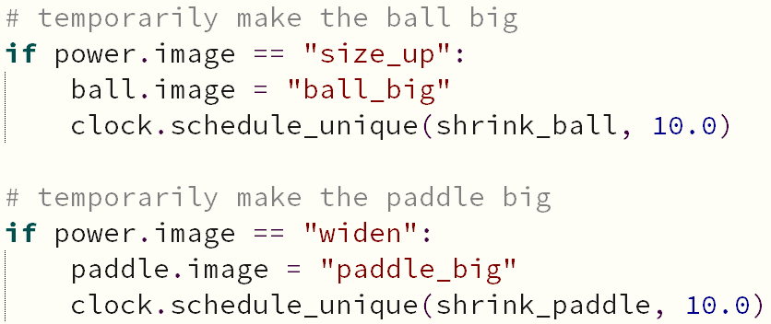
Ending The Power-ups – Part 2
Now, in the power-up section, schedule a function call with the following code.
The first argument selects the function to call, and the second argument is the amount of time (in seconds) to wait until calling the function

Slide 52
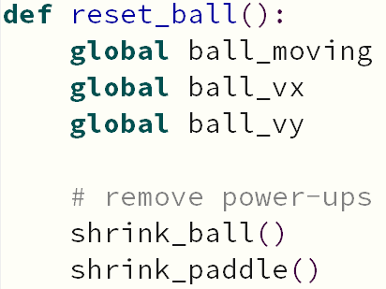
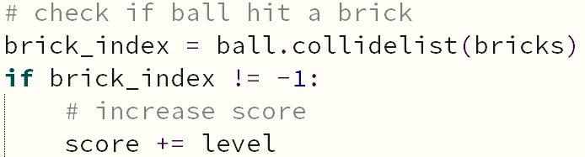
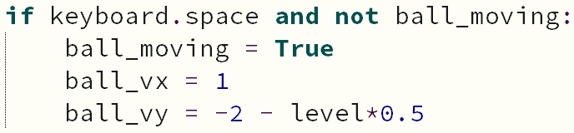
Some extra stuff!
When we reset the ball, you should remove all active power-ups
Change your score increase so that you score more points in higher levels
Change the ball_vy speed so that the ball moves faster in higher levels

